Slide 1
Problem: Tsunami Alert (AB2) Ministry: MSME Development Organization TEAM: ASHWAMEDHA

Slide 2

INDEX
Basics of Tsunami
Our Methodology
Tsunami Detection
Remote Earthquake based Tsunami Prediction
Features and Alert mechanism
Analysis
Advantages
Dependency
Opportunities

Slide 3
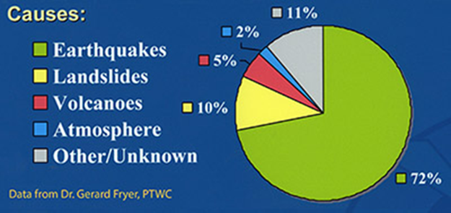
Tsunami
Definition-
A Tsunami is a vast volume of seawater in motion, extending from the surface to the ocean floor.
It is a series of long-period waves created by an abrupt disturbance that displaces a large amount of water.
When the tsunami strikes as a wall of water, sea levels can rise many meters.
Water level has risen to more than 50 feet (15 meters) for tsunamis of distant origin and over 100 feet (30 meters) for tsunami waves generated near the epicentre.

Slide 4
OUR METHODOLOGY

Slide 5
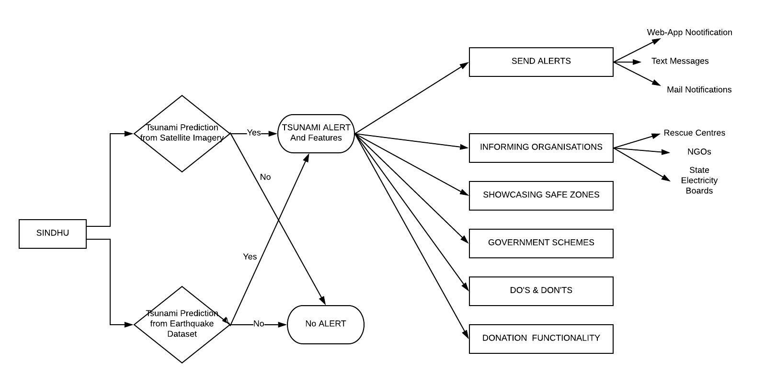

Slide 6
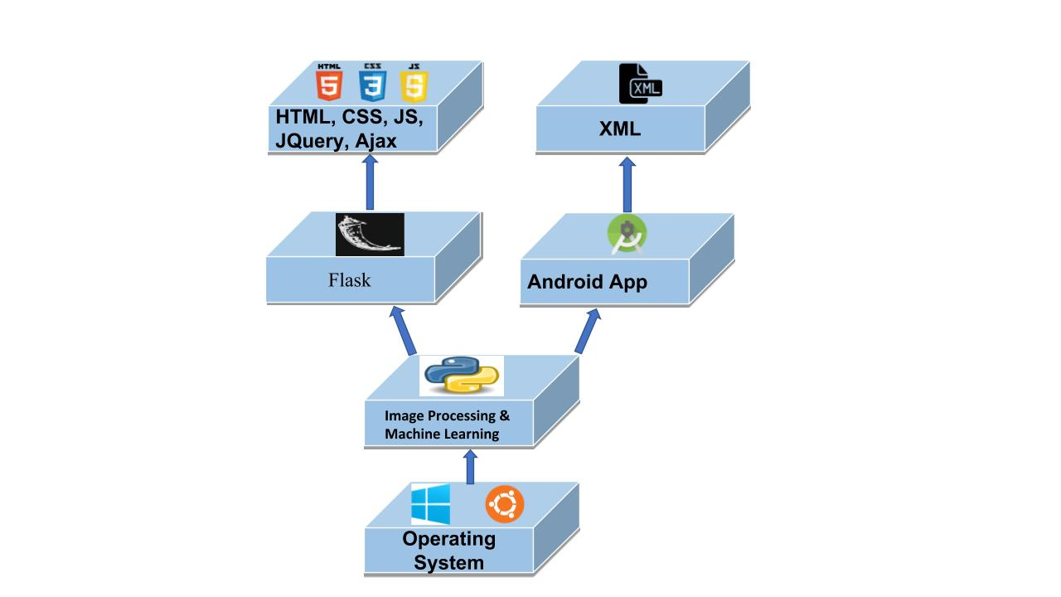
Technology Stack

Slide 7
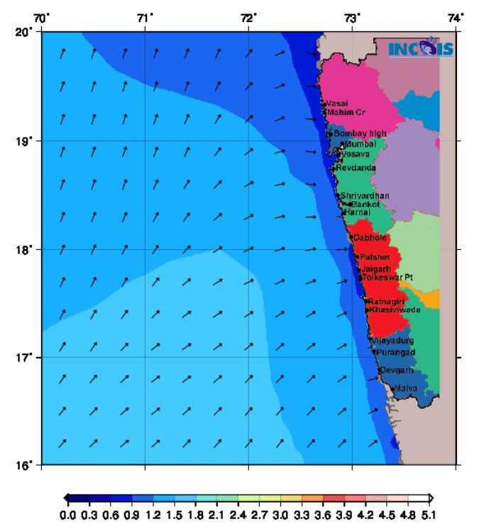
Tsunami Detection using GPS and Satellite Imagery
INCOIS data
Real-time monitoring of depth of the sea water level near the coastal regions of India.
State-wise sea level monitoring

Slide 8
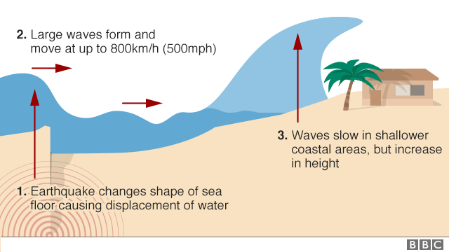
Tsunami Prediction based on Remote Earthquake
Kaggle dataset (latitude, longitude, magnitude, depth)
Random Forest Classification
Early warnings and alerts

Slide 9
WEB portal + APP………………….Why?
WEB : Intended to send alerts to government organizations, NGOs as well as Rescue Centres & State Electricity Boards.
APP : Mostly for alerting civilians.

Slide 10
Features and Alert Mechanism
Informing Organizations
Sending Alerts
Showcasing Safe zones
Donation functionality
Government Schemes
Do’s and Don’ts

Slide 11
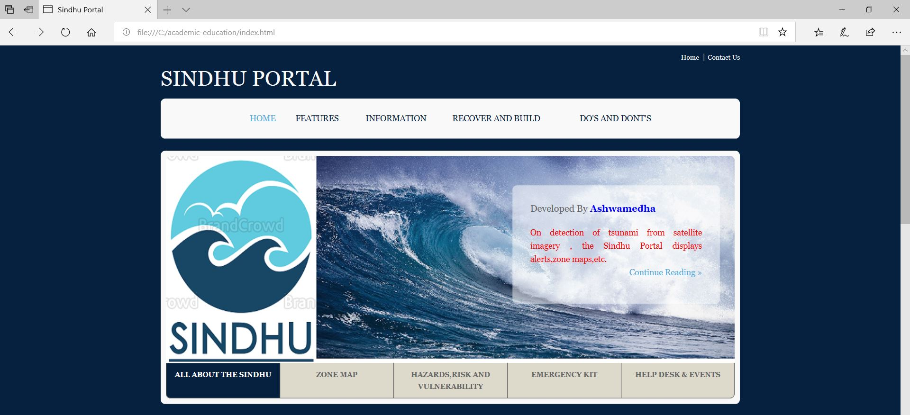
Web Portal(before Alerts)

Slide 12
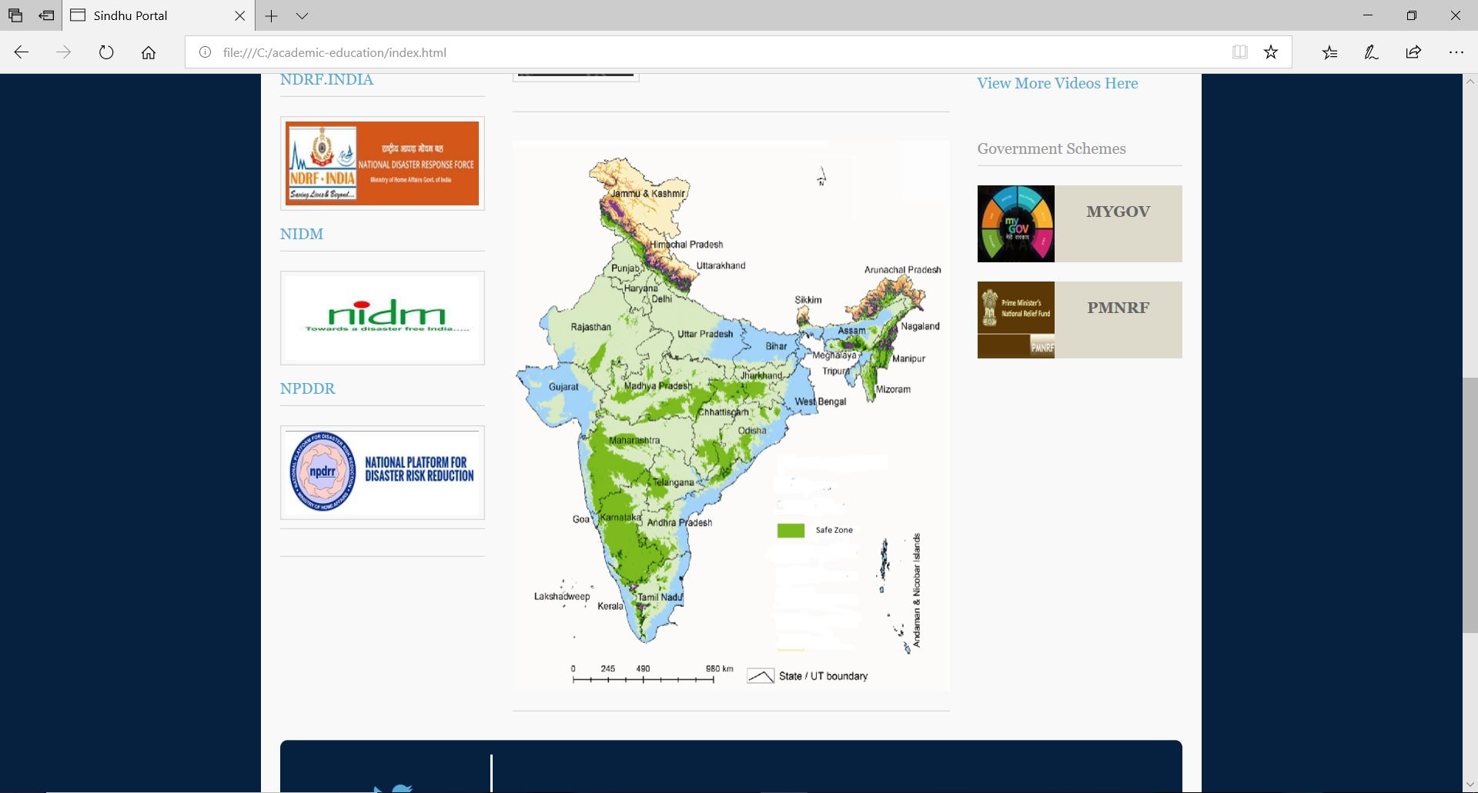
Safe Zones Showcasing:

Slide 13
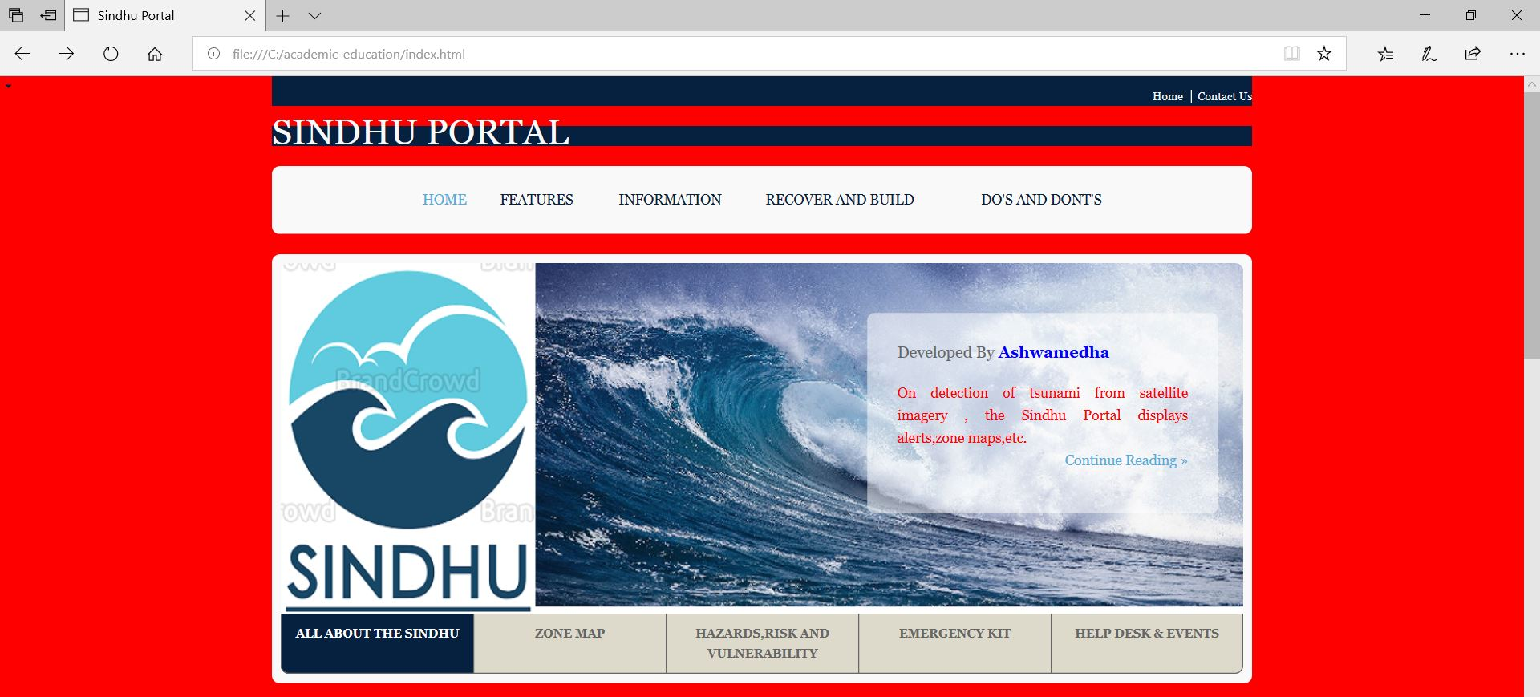
Web Portal(Alert)

Slide 14
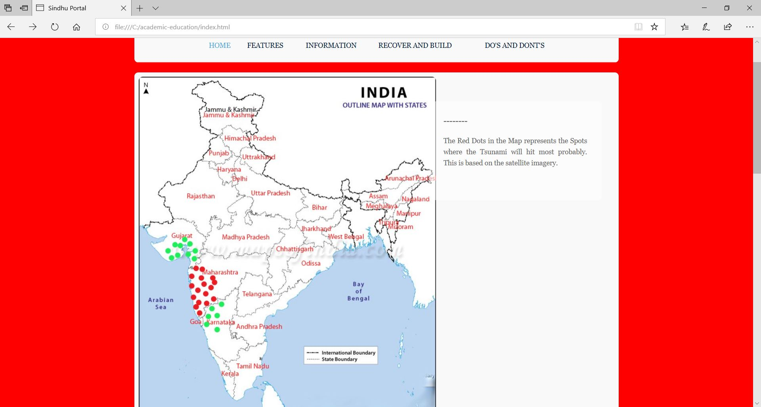
Location Specific:

Slide 15
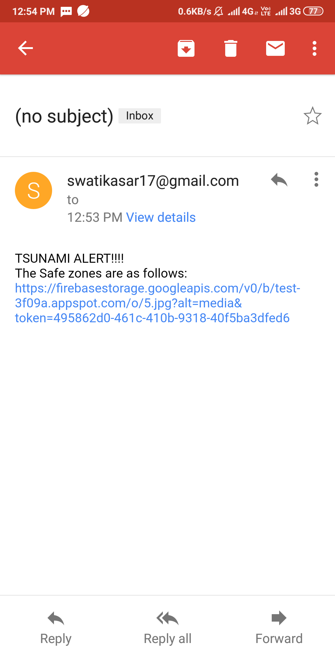
Email Notfications

Slide 16
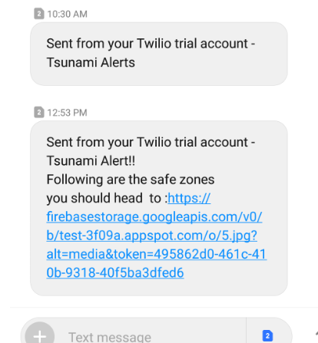
Text Messages:

Slide 17

Analysis

Slide 18
ADVANTAGES
Real-time 24x7 monitoring
Rich experience, good practices and related Learning
Ad-hoc text messages alerting mechanism
Remote Earthquake based-Tsunami prediction

Slide 19
DEPENDENCY
Sea water level monitoring data of various organizations based on Satellite and GPS- INCOIS data
Kaggle Earthquake Dataset of Indian Sub-Continent

Slide 20
OPPORTUNITIES
Prediction of Earthquake, its place, time, magnitude and effects
Supporting post-disaster management at root-level
Analysis of after shocks of distant eathquakes

Slide 21
THANKS!

